Slide 1
Hash, Don’t Cache
(the Page Table)
Idan Yaniv, Dan Tsafrir
SIGMETRICS / IFIP 2016
Notes:
This project has received funding from the European Union's Horizon 2020.

Slide 2
“ Virtual memory was invented in a time of scarcity. Is it still a good idea? ”
Charles Thacker, ACM Turing Award Lecture, 2009
Notes:
Let me start with a quote from Charles Thacker in his Turing award lecture in 2009.
Thacker said that virtual memory was invented in those old days when memory was scarce.
But today we have machines with hundreds of GBs of RAM, and virtual memory may not be the best idea.
https://www.youtube.com/watch?v=QVhQSINWml8
minute 35:00

Slide 3
Radix page tables
virtual address
hit?
physical address
TLB
miss?
index 4 | index 3 | index 2 | index 1 | offset
up to 20% of the runtime!
PTE
PTE
PTE
PTE
data page
CR3
Notes:
The problem with virtual memory today is that x86 architectures implement it with radix page tables.
For each memory access, the TLB tries to translate the virtual address to a physical address.
If the TLB misses we have to walk 4 levels in the radix page table: we take the virtual address and break it into 4 indexes and a page offset.
Each index selects a page table entry (PTE) which points to the next level, and so on until the last entry points to the data page the we were looking for.
We end up with 4 memory references for each TLB miss ! TLB misses take dozens or hundreds of CPU cycles, and may account for up to 20% of the runtime [1].
[1] Prof. Bruce Jacob, “Trends in Memory Systems”
https://www.ece.umd.edu/~blj/talks/Sun-Workshop.pdf

Slide 4
TLB misses are the bottleneck
 | TLB size [entries] | L1 cache | L2 cache
Ivy Bridge (2013) | 512 | 64 KB | 256 KB
Haswell (2013) | 1024 | 64 KB | 256 KB
Broadwell (2015) | 1536 | 64 KB | 256 KB
Notes:
Well, another evidence that the TLB misses are the bottleneck in many systems we can find if we look at the trends of recent Intel microarchitectures:
The TLB of Ivy Bridge contained 500 entries, then the TLB doubled in Haswell, and then tripled in Broadwell.
At the same time, the L1 and L2 data caches remained unchanged.
This means that Intel also identified the virtual memory performance as a problem.
/*** Moreover, the Broadwell microarchitecture added a second page walker to handle TLB misses in parallel with the primary one.
AMD even declared they use another TLB structure in the host dimension (nested TLB). ***/

Slide 5
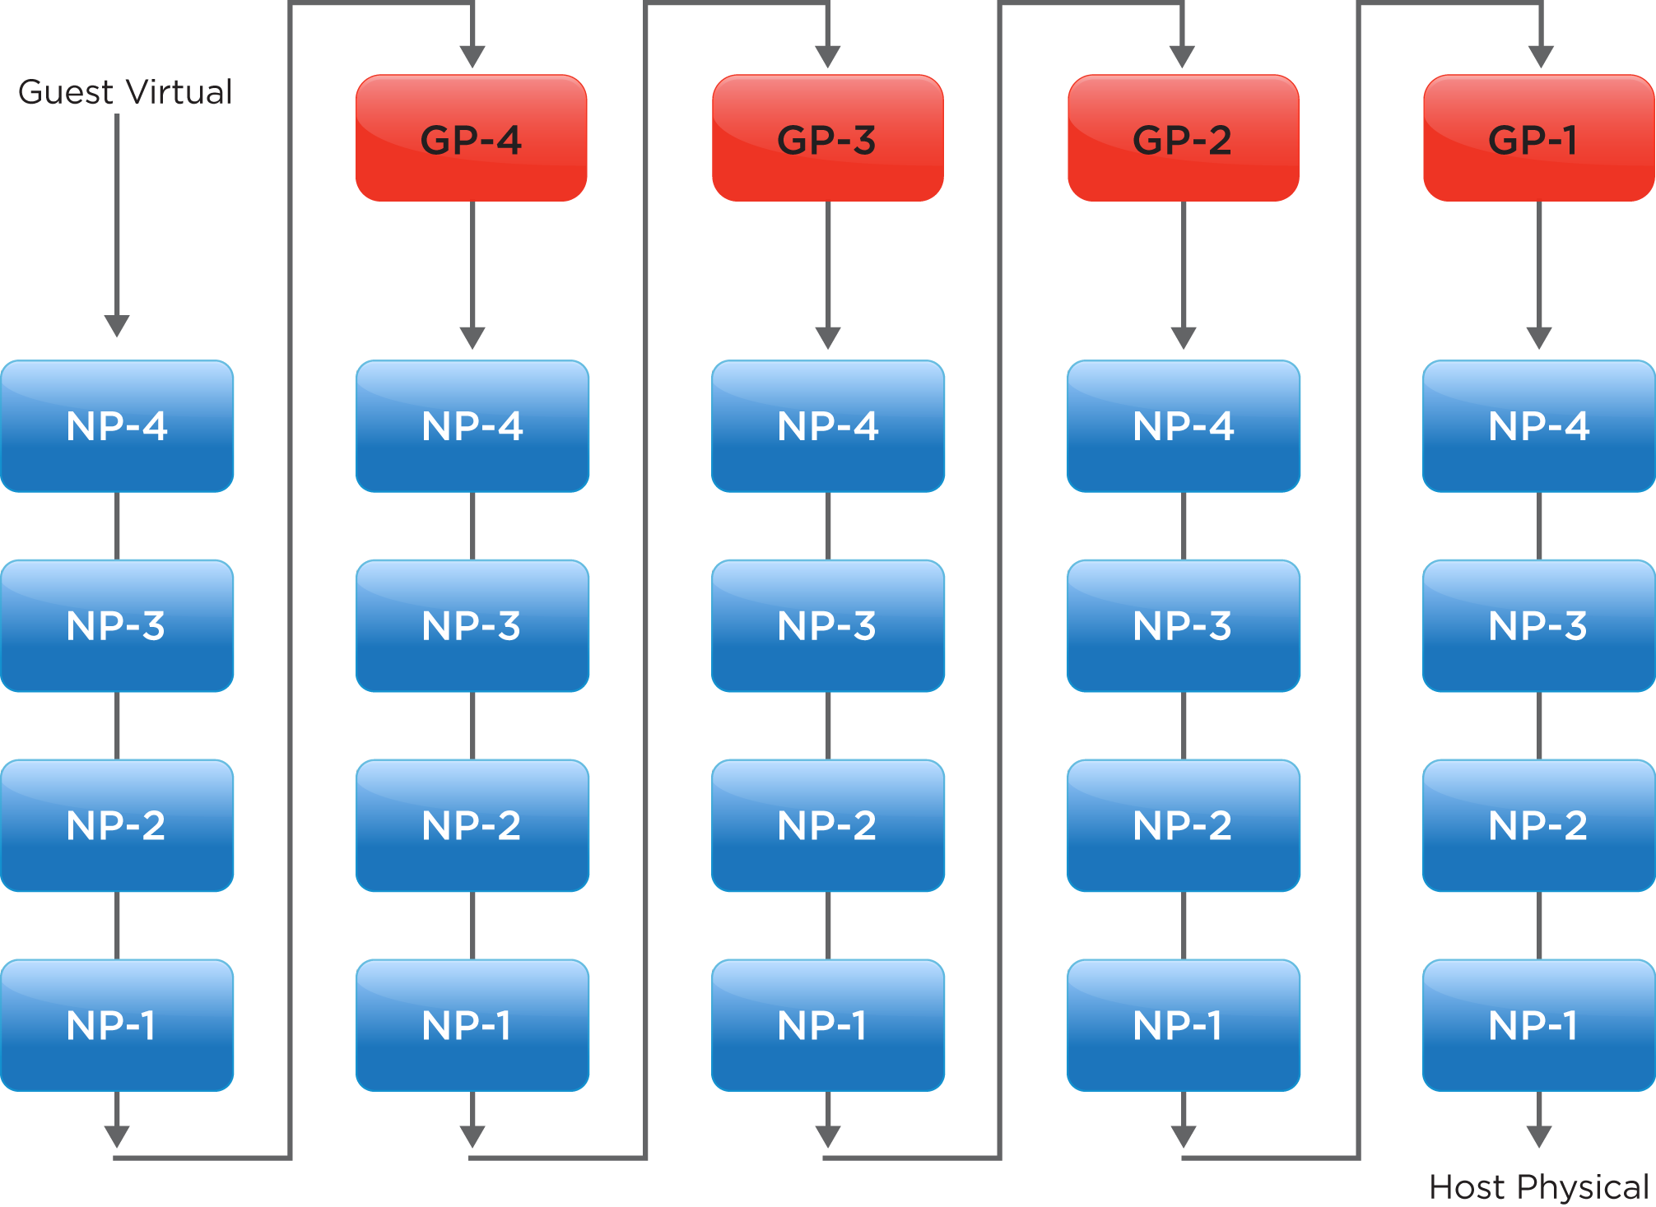
Virtualization requires 24 steps
guest page walk
Context
host page walk
up to 90% of the runtime!
Notes:
And the problem of TLB misses gets even worse in virtual machines, because now each TLB miss costs 24 memory references.
The reason is that virtualization utilizes two layers of page tables, one for the guest and one for the host.
The page walk process is two dimensional, because it walks the two tables simultaneously.
The red boxes are the 4 steps in the guest page walk, just like the 4 steps in the bare-metal case we saw before.
But now, the guest physical addresses, are in fact the host virtual addresses, so they require nested page walks in the host dimension.
We end up with 24 steps for each TLB miss, so they may account for up to 90% of the runtime in virtualized setups [1].
[1] Ravi Bhargava, Benjamin Serebrin, Francesco Spadini, and Srilatha Manne.
Accelerating two-dimensional page walks for virtualized systems, ASPLOS 2008
Additionally, 75% of x86 workloads run in virtual machines today [2].
[2] Thomas J. Bittman, Philip Dawson, Michael Warrilow,
"Magic quadrant for x86 server virtualization infrastructure",
Tech. Rep. ID:G00268538, Gartner, Inc., July 2015.
http://www.gartner.com/technology/reprints.do?id=1-2JFZ1KP&ct=150715

Slide 6
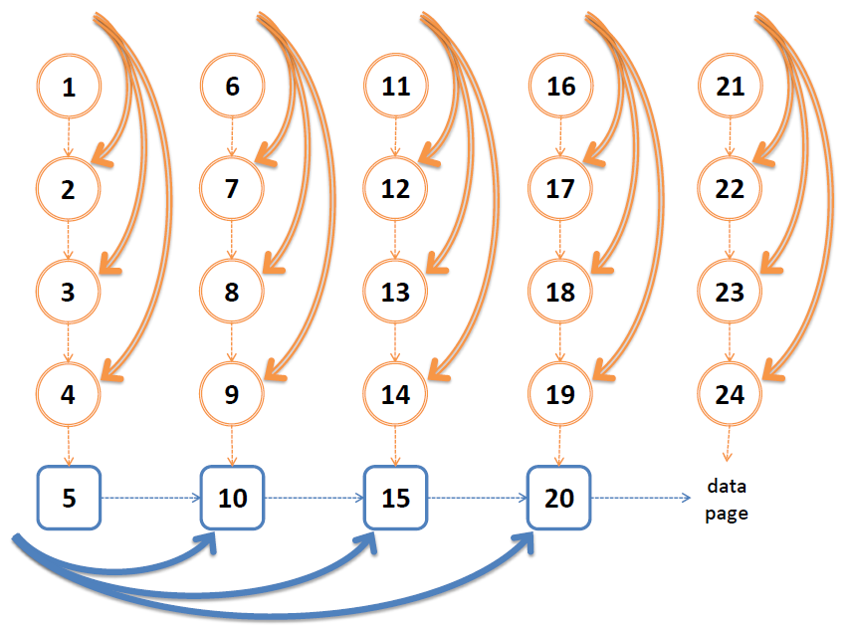
Page walk caches (PWCs)
Notes:
Intel obviously noticed the problem and introduced page walk caches, which accelerate page walks.
Basically, page walk caches store partial translations that enable to skip over some levels in the radix tree.
Later, Intel added another page walk cache for the host level, to speed up 2D page walks.

Slide 7
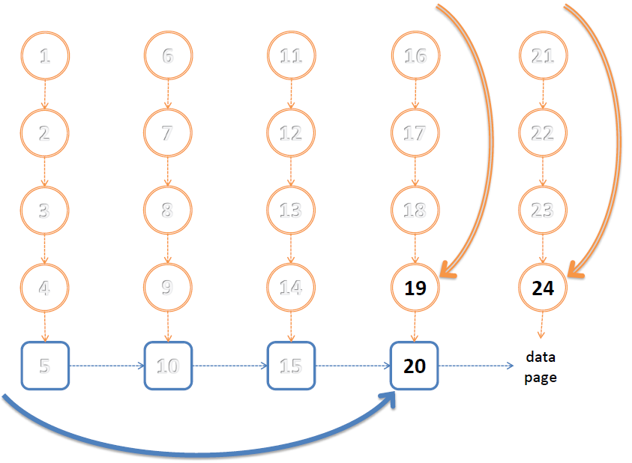
PWCs in best-case scenario
Context
Problem statement
Notes:
PWCs indeed cut down page walks, and in the best-case scenario,
when we always hit the PWC, we skip over the 3 uppermost levels.
So bare-metal page walks only need 1 memory access,
and virtualized page walks are shortened to 3 memory accesses.

Slide 8
So radix cause long page walks, and PWCs try to cut them down…
Notes:
So… radix page tables cause long page walks, and PWCs try to cut them down.
And we thought to ourselves: If only we had shorter page walks in the first place… that would be great.

Slide 9
Hashed page tables do that!
memory refs. per walk
 | radix | optimal radix | hashed
bare-metal | 4 | 1 | 1
virtualized | 24 | 3 | 3
without page
walk caches !
Notes:
Actually, that’s what hashed page tables do: they offer page walks of 1 and 3 memory references in bare-metal and virtualized setups,
compared to 4 and 24 with radix page tables. In fact, hashed page tables work like the optimal radix design,
where we have page walks of 1 and 3 memory references in the case when the PWCs always hit.
So they don’t require additional page walk caches.

Slide 10
Then why not hashed?
legacy, of course.
some claim that hashed perform poorly.
Notes:
Sounds great, then why not using hashed?
The main reason is legacy, of course. Intel tries to remain backward compatible.
But also, some researchers claim that hashed perform poorly...

Slide 11
“[hashed page table] increases the number of DRAM accesses per walk by over 400%”
“Skip, Don’t Walk (the Page Table)”, ISCA 2010
Notes:
Specifically, an ISCA paper from 2010 concluded that:
“[hashed page table] increases the number of DRAM accesses per walk by over 400%”
And I’d like to mention that ISCA is a top-tier venue for computer architects.

Slide 12
Notes:
Yes, you heard right. 400% more DRAM references…
This is were our study began.

Slide 13
We found out that this statement is only true for the Intel Itanium design !
Notes:
However, we found out that this statement is only true for the Intel Itanium design!

Slide 14
In this talk we will
revisit the Itanium hashed page table.
present 3 improvements.
debunk ISCA’10 finding, and show that hashed can perform better than radix+PWCs.
Notes:
So the plan for today is:
first, revisit the Itanium hashed page table, and study its drawbacks in detail.
Then, we will present 3 improvements to this basic design.
And finally, we will debunk the ISCA paper finding, and show that the optimized hashed page tables can perform better than radix with PWCs.

Slide 15
Itanium hashed page table
virtual page number | offset
hash
hash table
tag | PTE
tag | PTE
tag | PTE
CR3
Notes:
OK, so let’s dive into the details and explain how the Itanium hashed page table works.
We take the virtual page number, and instead of breaking it into indexes, we hash it into some slot, and then compare it to the tag.
If there is a match, the translation was found.

Slide 16
Itanium hashed page table
virtual page number | offset
hash
hash table
tag | PTE
tag | PTE
tag | PTE
chain table
tag | PTE
tag | PTE
CR3
Notes:
But if there is a mismatch, we follow the pointer to examine the next slot until we find a match,
or reach a null pointer, indicating that the translation does not exist.
/*** Note that there is a separate chain table to store the elements
that collided with other elements in the hash table. ***/

Slide 17
Itanium hashed page table
only 1 memory access per walk ! ☺
assuming no collisions… ☹
but in practice it suffers from:
chain pointers waste space ☹
poor locality ☹
tags waste space ☹
Notes:
In the common case, Itanium requires only 1 memory reference per walk. But in practice, we have hash collisions that make the page walks longer.
The Itanium design also suffers from three other drawbacks: First, the chain pointers waste space.
Second, there are locality problems. And third, the tags also waste space.

Slide 18
Weakness #1: chain pointers waste space
radix entry | hashed entry
8 bytes | 32 bytes
PTE
tag | PTE | pointer
Notes:
The first problem with the Itanium design is that the chain pointers waste space.
Radix entries are 8 bytes long since they contain only the PTE, but hashed entries are 32 bytes long since they also save tags and chain pointers.

Slide 19
Weakness #1: chain pointers waste space
radix entry | hashed entry
8 bytes | 32 16 bytes
PTE
tag | PTE | pointer
➔ twice more entries!
Notes:
If we got rid of the chain pointers, we could save a lot of space and allocate twice more entries.
And twice more entries means less hash collisions and shorter page walks.

Slide 20
Solution #1: open addressing
virtual page number | offset
hash
hash table
tag | PTE
tag | PTE
tag | PTE
chain table
tag | PTE
tag | PTE
CR3
Notes:
Therefore our first proposal is to get rid of the wasteful chain pointers (and chain table)
by switching to the open addressing scheme.
The open addressing technique no longer uses pointers to resolve hash collisions.

Slide 21
Solution #1: open addressing
virtual page number | offset
hash
tag | PTE
tag | PTE
tag | PTE
tag | PTE
collision?
CR3
Notes:
When a hash collision occurs, we just examine the next slot in the table. And again, the search ends when we find a match or reach an empty slot.

Slide 22
Solution #1: open addressing (➔ decrease the load factor)
load factor = | occupied slots
 | total slots
load factor | ½ | ¼ | ⅛
page walk length | 1.5 | 1.15 | 1.07
Notes:
Now we can turn the space we saved to good use by allocating twice more slots and decreasing the load factor.
The load factor is the ratio of occupied slots to the total number of slots.
The ISCA paper set the load factor to ½, and got 1.5 references per walk on average [1].
We decreased the load factor to ¼ and shortened the page walk length to 1.15.
[1] http://www.brpreiss.com/books/opus5/html/page248.html

Slide 23
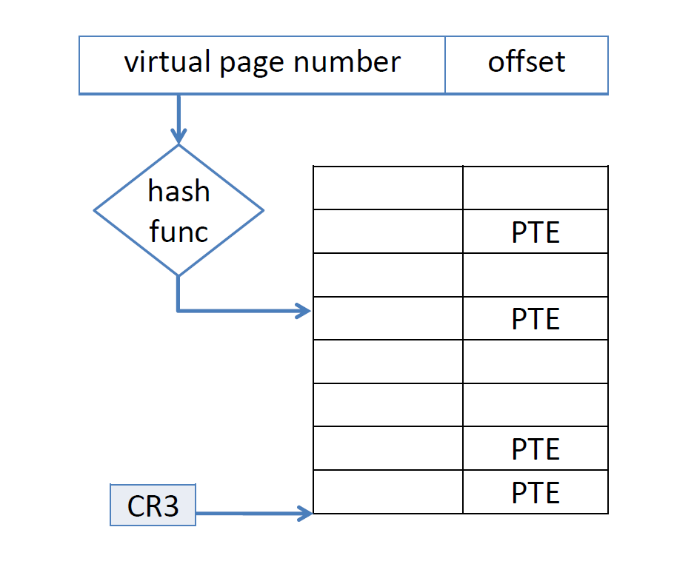
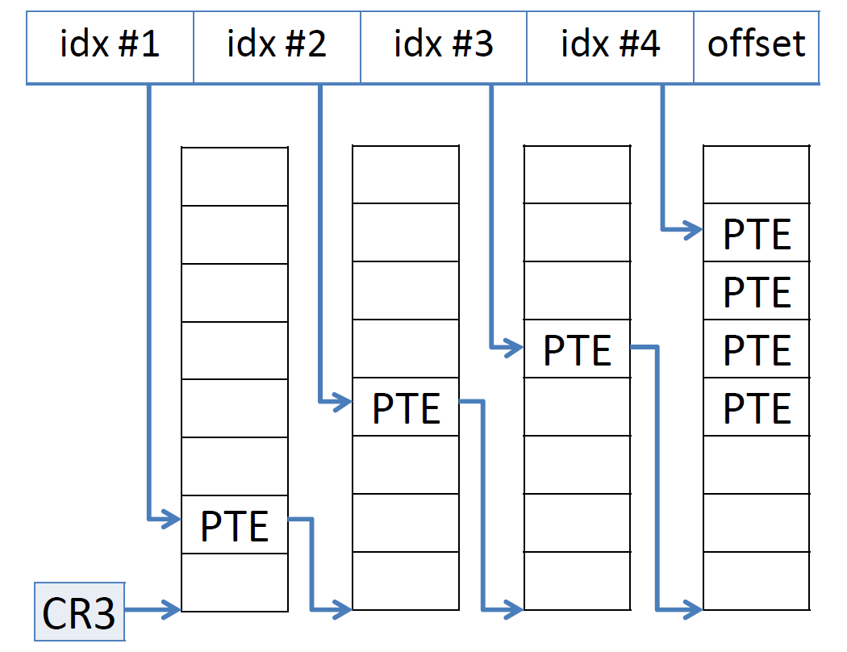
Weakness #2: poor locality
in radix, consecutive mappings are adjacent:
in hashed, mappings are scattered:
Notes:
Another weakness of hashed page tables is their poor locality of reference.
Radix page tables keep the mappings of consecutive pages in adjacent slots.
Hashed page tables, on the other hand, scatter the mappings all over the hash table.
Remember that page table data is cached in the L1, L2 and L3 caches.
So when a radix page walk reads a PTE, it implicitly prefetches the other mappings that lie
in its cache line, and there is a good chance that they will be accessed as well in the future.
Hashed page walks, on the other hand, do not exploit locality at all.

Slide 24
Solution #2: clustering
Talluri, Hill, and
Khalidi in 1995
page number
block number | block offset | offset
hash
64-byte cache line
tag | PTE0 | PTE1 | PTE2 | PTE3
tag | PTE0 | PTE1 | PTE2 | PTE3
CR3
Notes:
Therefore, the second improvement is to use clustering as was proposed by Talluri, Hill, and Khalidi in 1995.
The idea is to pack consecutive mappings together in the same slot.
For example, if we pack 4 mappings in each slot, the page walk looks like this:
We break the page number into a block number and a block offset.
The block number hashes to a table slot, and the block offset indexes into the array of PTEs stored in the slot.
Now, whenever the page walk brings a cacheline, it brings multiple translations of consecutive pages.

Slide 25
Weakness #3: “tag” field wastes space
hashed pack 4 PTEs:
tag | PTE0 | PTE1 | PTE2 | PTE3
64-byte cache line
radix pack 8 PTEs:
PTE0 | PTE1 | PTE2 |  |  |  |  | PTE7
Notes:
And the last problem is that hashed page tables still waste more space than radix.
Hashed designs pack only 4 PTEs, because they must keep the tag field to resolve hash collisions.
Radix, on the other hand, pack 8 PTEs into a single cache line.
This makes radix more attractive because the caches can cover twice as much PTEs for the same number of cachelines.

Slide 26
Solution #3: compaction
 | tag |  | PTE0 |  | PTE1 |  | PTE2 |  | PTE3
tag | PTE0 | PTE1 | PTE2 | PTE3
tag | PTE0 | PTE1 | PTE2 |  |  |  |  | PTE7
Notes:
But actually, we have a lot of unused space hiding in the tag field and the PTEs, since current CPUs only use 48 bits of virtual and physical addresses.
We found out that we can use this free space and squeeze together the tag plus 8 PTEs in the same cache line.
So now both radix and hashed pack the same number of PTEs in a single cache line!

Slide 27
Solution #3: compaction (➔ decrease the load factor)
load factor = | occupied slots
 | total slots
load factor | ½ | ¼ | ⅛
page walk length | 1.5 | 1.15 | 1.07
Notes:
Compaction allows us to decrease the load factor by half, since it cuts by half the number of occupied slots.
So we decrease the load factor further to 1/8 to shorten the page walk length to 1.07.
[1] http://www.brpreiss.com/books/opus5/html/page248.html

Slide 28
Summary: how we improved the Itanium?
Notes:
To summarize the improvements together.

Slide 29
Itanium baseline
virtual page number | offset
hash
hash table
tag | PTE
tag | PTE
tag | PTE
chain table
tag | PTE
tag | PTE
CR3
Notes:
we started with the basic Itanium design.

Slide 30
Itanium baseline ➔ open addressing
virtual page number | offset
hash
tag | PTE
tag | PTE
tag | PTE
tag | PTE
collision?
CR3
Notes:
Then switched to the open addressing scheme, saved space, and decreased the load factor.

Slide 31
Itanium baseline ➔ open addressing + clustering
block number | block offset | offset
hash
tag | PTE0 | PTE1 | PTE2 | PTE3
tag | PTE0 | PTE1 | PTE2 | PTE3
CR3
Notes:
We then used clustering to leverage the locality of reference.

Slide 32
Itanium baseline ➔ open addressing + clustering + compaction
block number | block offset | offset
hash
tag | PTE0 | PTE1 | PTE2 | PTE3 | PTE4 | PTE5 | PTE6 | PTE7
64-byte cache line
CR3
Notes:
And last, we compacted 8 page table entries in each cache line, just like radix.

Slide 33
hashed radix
Notes:
That’s all for the technical details.
We are now ready to compare our improved hashed design to radix as implemented in current Intel processors.

Slide 34
Hashed perform better than existing x86-64 hardware
reducing benchmark runtimes by
1%–27% in bare-metal setups,
6%–32% in virtualized setups,
without resorting to page walk caches.
* for comparison: Haswell is up to 6% faster than Ivy Bridge.
Notes:
In a nutshell, hashed page tables perform better than existing x86-64 hardware,
reducing benchmark runtimes by 1%–27% in bare-metal setups and 6%–32% in virtualized setups, for the benchmarks tested.
It’s important to notice that we compare against current Intel processors which employ page walk caches,
whereas hashed page tables do not use page walk caches.
This are significant improvements. For comparison: Haswell is up to 6% faster than Ivy Bridge.

Slide 35
Hashed approximate optimal radix (i.e., infinite PWCs which never miss)
average runtime improvement
 | hashed | optimal radix
bare-metal | 8 % | 6 %
virtualized | 17 % | 16 %
Notes:
Actually, hashed page tables approximate the optimal radix, that is, radix equipped with infinite PWCs which never miss.
Infinite PWCs are not realistic of course, but their performance sets a lower bound on radix performance.
This table presents the runtime improvement with hashed and with infinite PWCs, and we can see that the two designs improve the runtime by about the same amount.
That is 6-8% in bare-metal setups, and 16-17% percents in virtualized setups.

Slide 36
SPEC CPU2006
31 benchmarks.
memory footprint < 2GB.
most of the benchmarks exhibit very few TLB & PWC misses; for them hashed and radix perform equally well.
3 benchmarks are sensitive to PWC misses.
Notes:
Let’s take a closer look at the benchmarks from the well-known SPEC CPU2006 suite.
There are 31 benchmarks in the suite with memory footprint of less than 2GB,
so most of them exhibit very few TLB and PWC misses, and for them hashed and radix perform equally well.
But 3 benchmarks are sensitive to PWC misses, and they show notable improvements when using hashed page tables.

Slide 37
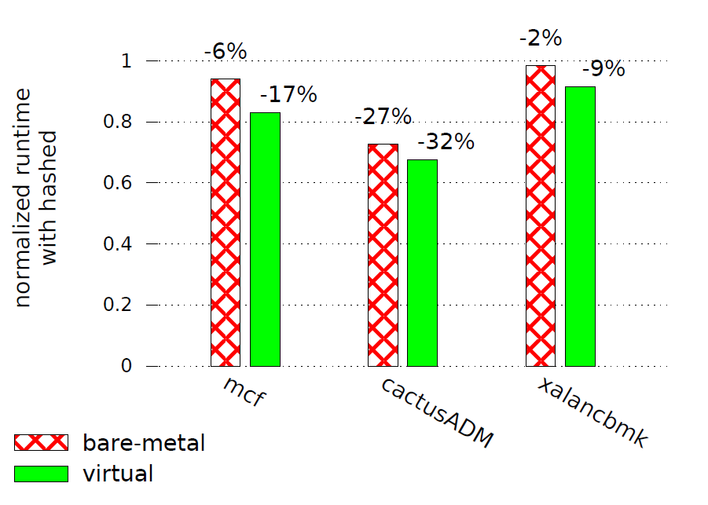
SPEC CPU2006
Notes:
These are the mcf, cactus, and xalan benchmarks.
The figure shows the runtime improvement from using hashed instead of radix with PWC sizes as in the current Intel processors.
For each benchmark we estimated the improvement in the bare-metal and the virtualized case.
The numbers above the bars are the runtime savings we will get from using hashed,
and we can see the gain is bigger in the virtualized scenario, as we expected.

Slide 38
Radix page tables do not scale
as the memory footprint grows.
as the locality of reference drops.
as more virtualization layers are added.
Notes:
Another important conclusion is that radix page tables do not scale,
because they rely on limited size page walk caches.
So when the memory footpring grows, when the locality of reference drops,
or when we add layers of virtualization, the performance of the radix page tables with their page walk caches degrades.

Slide 39
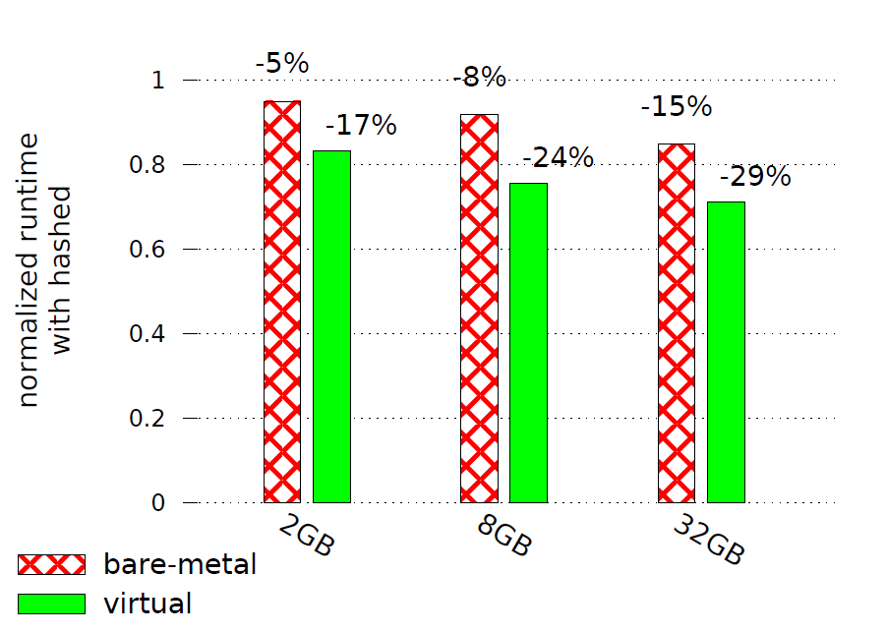
GUPS - reads & updates random memory
Notes:
We demonstrate this statement by measuring the GUPS benchmark, which reads & updates random cells in some array.
We examined 3 different input sizes of 2, 8, and 32 GB.
We can see that the improvement gains are bigger as the memory footprint grows. And again, the improvement in virtualized setups is bigger than in bare-metal setups.

Slide 40
Nested virtualization
for $d$ levels of virtualization, with page walk length of $L$ at each level, the overall page walk length is ${\left(L+1\right)}^{d} – 1$
 | hashed ($L=1$) | radix ($L=4$)
bare-metal | 1 | 4
virtualized | 3 | 24
nested virt. | 7 | 124
Notes:
And the last contribution we made is deriving the overall page walk length for nested virtualization.
We showed that for d levels of virtualiztion, with page walk length of L at each level,
the overall page walk length is (L+1) raised to the power of d.
Since we proved that the page walk length grows exponentially with the number of virtualization layers,
hashed page tables are exponentially more efficient than radix designs.

Slide 41
Methodology or: how to evaluate HW that doesn’t exist?
Notes:
I’d like to talk a bit about our methodology.
We presented some nice performance numbers, and you probably ask yourselves how reliable they are.

Slide 42
Methodology
state-of-the-art in virtual memory research.
used by:
Basu, Gandhi, Chang, Hill et. al., ISCA 2013.
Bhattacharjee, MICRO 2013.
Gandhi, Basu, Hill et. al., MICRO 2014.
Notes:
We used the common methodology in researches concerning virtual memory.
We used this methodology to get the results that you have seen so far.

Slide 43
Methodology
Phase 1 (off-line): build a model.
Phase 2 (on-line): simulate and apply.
runtime
runtime
walk
cycles
walk
cycles
simulation
Notes:
They methodolgy consists of two phases.
In the first phase we built a linear model that predicts the runtime from the walk cycles, i.e., the cycles spent during page walks.
We used the HW counters available on Intel processors: the number of cycles spent in page walks, and the total number of cycles.
We collected measurements on a real system and built this model.
In the second phase we simulated the benchmarks, took the simulation output and plugged it into the model to predict the runtime.

Slide 44
Conclusions

Slide 45
Radix vs. Hashed
 | radix | hashed
big memory | ✗ | ✓
low locality | ✗ | ✓
nested virtualization | ✗ | ✓
Notes:
To conclude: radix designs rely on limited-size page walk caches, so they do not scale as workloads access larger memory regions with low locality.
Moreover, the performance of radix designs degrades dramatically when more levels of virtualization are added.
Hashed page tables, on the other hand, require the same number of memory references per walk, regardless of the memory footprint or the access pattern of the application, and their performance degrades moderately with virtualization.
/*** Remember that DRAM capacity doubles every ~3 years (According to ITRS roadmap). ***/

Slide 46
Thanks for listening!
Questions?

Slide 48
Cons of hashed
multiple page sizes.
dynamic resizing.
Possible solution: segmentation.
another level of translation at larger granularity.
e.g. 256 MB segments.

Slide 50
Graph500
multi-threaded graph construction & BFS.
input sizes: 4 , 8 , 16 GB.
Notes:
Another important conclusion is that radix page tables do not scale,
because they rely on limited size page walk caches.
So when the memory footpring grows, when the locality of reference drops,
or when we add layers of virtualization, the performance degrades.

Slide 51
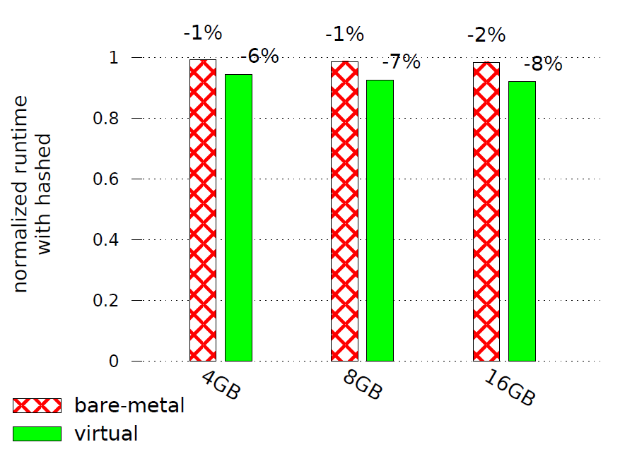
Graph500
Notes:
The improvements are more moderate for this benchmark.

